Slide 1

AI-Powered developers best friend
Next generation development assistant
10.25.2024

Slide 2




Meet the team
Arun Mishra
Umang Singh
Pradnya Adwankar
Ankith Jain

Slide 3
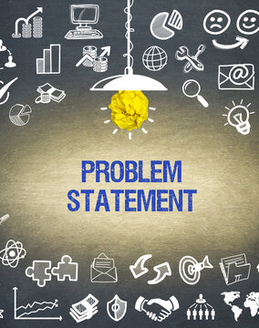
Problem statement
Engineering teams often struggle to deliver high-quality code quickly while managing dependencies, following best practices, and adopting new technologies. These productivity roadblocks not only affect development but also increase the Total Cost of Ownership. To overcome this, organizations must measure productivity, address key issues, and provide access to the right tools, training, and expert talent. By investing in the three "P"s—Products, Processes, and People—continuous productivity improvements can be achieved.

Slide 4
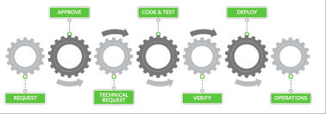

The Challenge
Development Bottlenecks
Technical Challenges
Time-consuming code reviews
Inconsistent code quality
Manual dependency management
Growing technical debt
Security vulnerabilities
Insufficient test coverage

Slide 5

The solution
AI-Powered Development Assistant
Seamless GitHub Integration
Automated Code Analysis & Improvement
Security Scanning & Dependency Management
Test Generation & Quality Assurance
Technical Debt Detection & Management

Slide 6
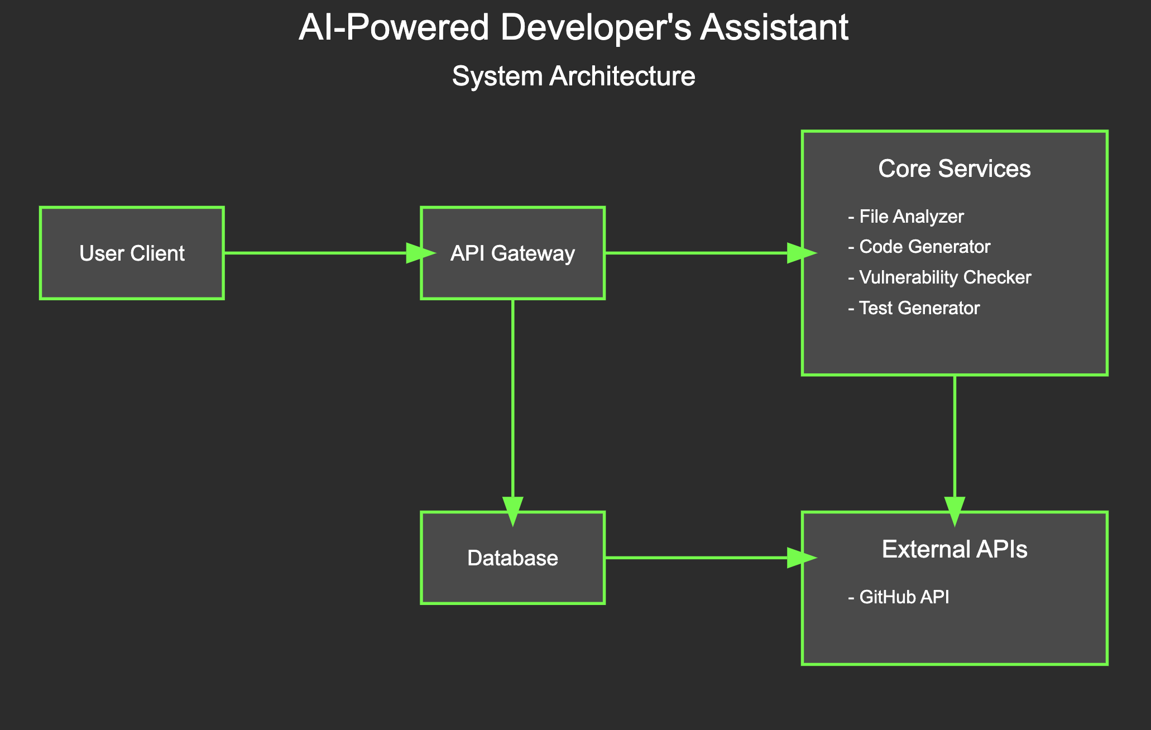
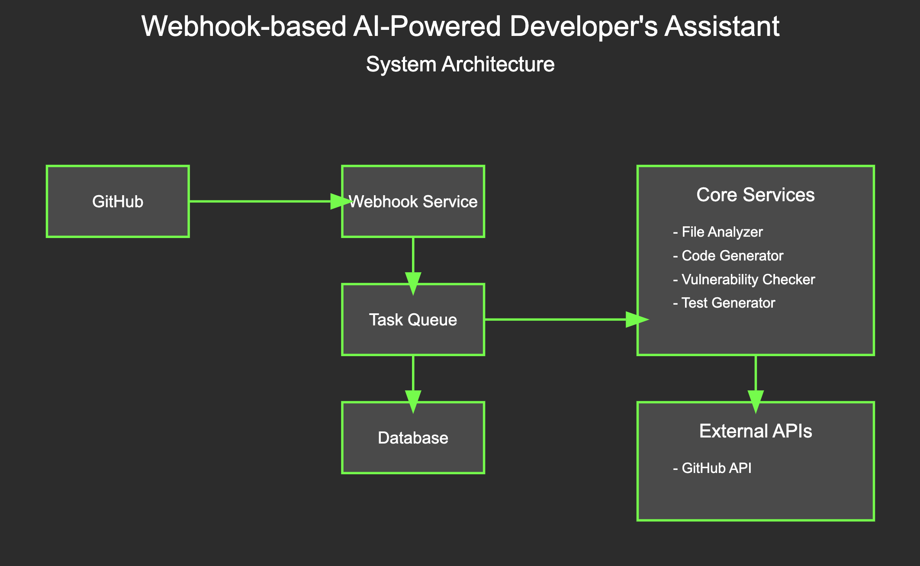
Architecture

Slide 7
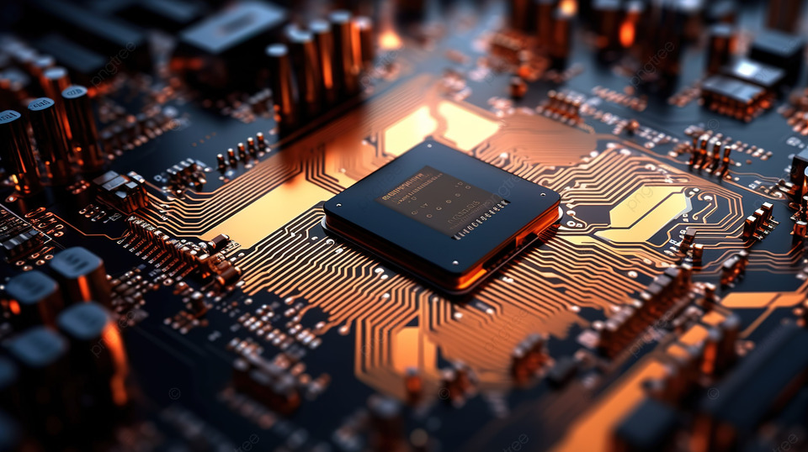

Components
Core Components
Key Services
GitHub Integration
Event Processing
Analysis Services
Pull request and repository Analyzer
Security Scanner
Test cases generator
Tech debt analyzer on repository or pull request

Slide 8
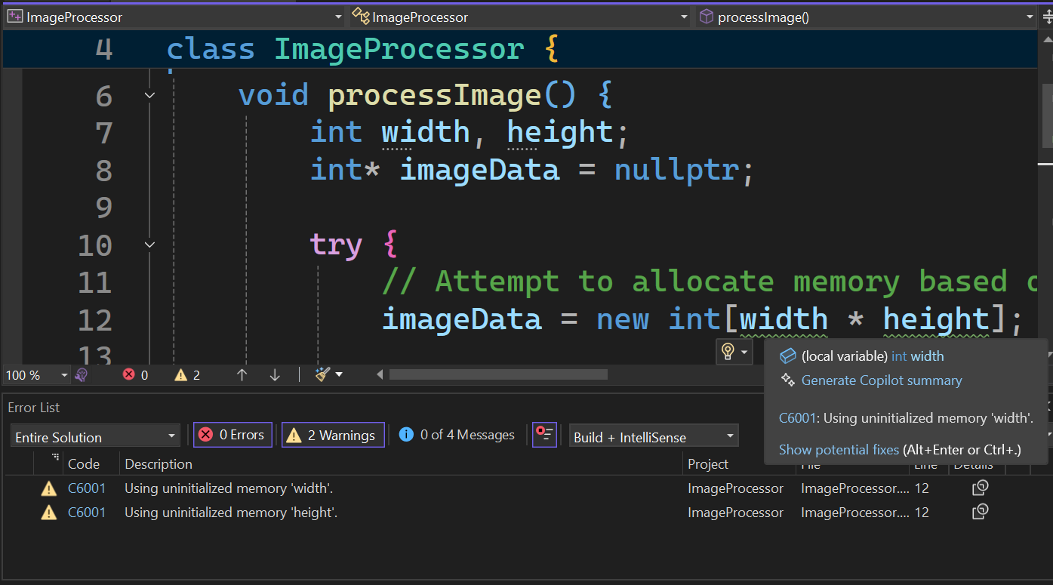



Key features
Code Analysis
AI-Powered Review
Quality Enhancement
Standards Enforcement
Security & Testing
Sensitive Info Detection
Test Generation
Dependency Updates
Automation
PR Creation
Version Migration
Security Reporting
Integration
GitHub Webhooks
GitHub Copilot
GitHub API and Extensions
OpenAI Integration

Slide 9


Impacts & benefits
For Developers
For Organizations
Reduced Manual Work
Improved Code Quality
Faster Development
Enhanced Security
Reduced Technical Debt
Standardized Processes

Slide 10
DEMO
Final Hackathon Demo Video
GitHub Repo: AI Powered Dveeloper's Best Friend

Slide 11


Future roadmap
Upcoming Features
Long-term Vision
Enhanced test generation
Automated pull request creation
Extended security reporting
Advanced AI capabilities
Multi-language support
Custom rule engine

Slide 12
THANK YOU

